Slide 1






PocketPaw Co: Human Resources
YOUR PET IN YOUR POCKET

Slide 2
Our team
David Pérez
Federico
Falcone
Guillem
Escriba
Oriol Soler
CEO
CFO
CEO
GENERAL MANAGER
Data Science Engineer
Computer Engineer
Data Science Engineer
Audiovisual Engineer

Slide 3

Organizational chart
GENERAL DIRECTION
BUSINESS DEVELOPMENT [0.5]
OPERATIONS
[2]
ADMINISTRATION
[3]
TECH
[1]
MARKETING & SALES [1.5]
GPS DEVELOPMENT [4]
WEB & APP DEVELOPMENT
[10]
Key departments
Our key departments at the start is the marketing and sales team, to make us a place in a very competitive market and out app development team to create a unique and useful app better than the ones of our competitors.

Slide 4
Organizational chart
GENERAL DIRECTION
BUSINESS DEVELOPMENT
[1]
OPERATIONS
[1]
ADMINISTRATION
[1]
TECH
[1]
MARKETING
[7]
SALES
[4]
PURCHASING & PRODUCTION
[1.5]
LOGISTIC
[0.5]
AFTER SALES
[2]
FINANCE GA
[2]
HUMAN RESOURCES
[3]
PRODUCT UPDATING
[11]
Key departments
Since we are in a very competitive market with some apps that have similar functions we need a powerful marketing department to diferentiate us. Also to remain in the market we need to constantly update the product to compete against our rivals.

Slide 5
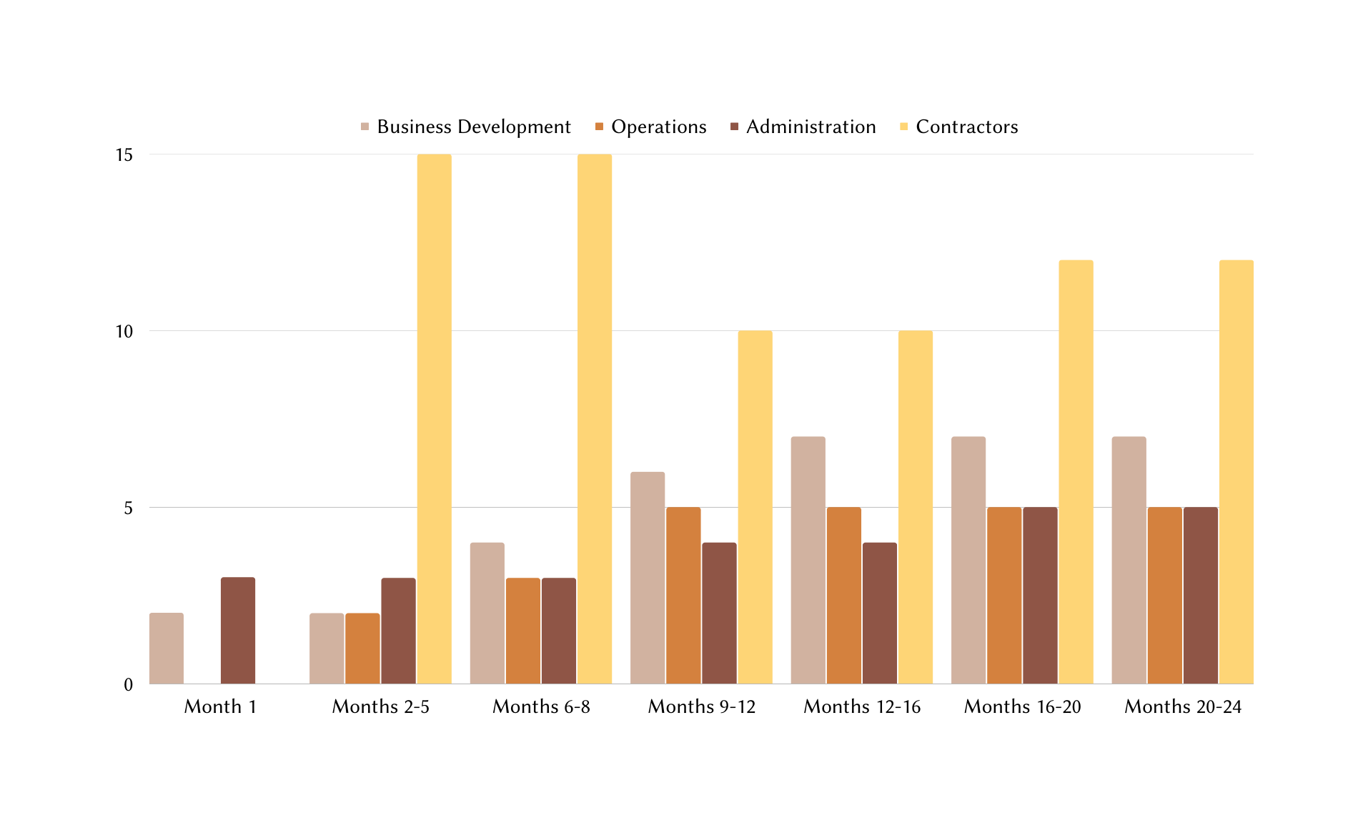
Company growth
Tech
FTE (headcount + contractors)
Company Creation
Development
Testing
Final Release
Corrections
Possible Updates
Time

Slide 6


HIRING POLICIES
SELECTION PROCESS
Initial selection
INTERVIEW
Hiring
EMPLOYEES
ADMINISTRATION
TECH
FORMATION: Business, finances & accounting.
EXPERIENCE: > 2 years.
PROFILE: Proficiency in management and organization, motivated to learn.
FORMATION: Software, Computer Science and Electronic Engineers.
EXPERIENCE: No experience/>5 years in APP dev.
PROFILE: Analytical and critical thinking, good problem solving skills and team working.
PURCHASING & PRODUCTION / SALES
MARKETING
FORMATION: Business, finances & accounting.
EXPERIENCE: > 2 years.
PROFILE: Good logistic skills, communication skills and previously worked in sales.
FORMATION: Marketing.
EXPERIENCE: > 5 years in Tech or Pet sector.
PROFILE: Good communication skills, people who are interested in pets, previously worked with apps marketing.

Slide 7



LEADERSHIP
BUSINESS DEVELOPMENT DEPARTMENT
OPERATIONS DEPARTMENT
Task behaviour.
Visionary (Common vision) and pacesetting (challenging objectives) leadership.
Relationship behaviour.
Pacesetting and authoritative (objectives are clear) leadership.
ADMINISTRATION DEPARTMENT
TECH DEPARTMENT
Relationship behaviour.
Democrat leadership.
Task behaviour.
Pacesetting, coaching (regarding capabilities) and authoritative leadership.

Slide 8
SUGGESTED WORKING METHODOLOGY
ALL TEAMS TREATED EQUALLY:
Roles and responsibilities will be clearly attributed to every team member.
To stimulate communication: Trimestral teams lunch. Also bring trimester results and evaluation.
Weekly meetings to set and update team objectives.
Compromising Strategy to solve team conflicts. Mutual agreement. Team head coordinates the resolution and mediates between the parts.
Intranetwork and team chat to help with teamwork.
Extra remuneration for achieving objectives in time. Increases productivity and motivation.
*This methodolgy would have minor changes after an expert advices (service we will be contracting)

Slide 9
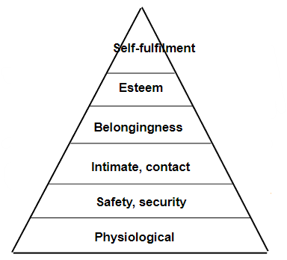
Employee motivation & retention
Physiological needs: corporate bonuses and rewards, work-life balance (possibility to schedule your day from 5 to 12 hours/day or partially work from home).
Safety: Middle-term contracts, reorganization.
Social needs: Open break zone, coworking (meet other companies' workers). Regular activities with the team.
Esteem needs: Recognition system, listen to employee feedback.
Self-fulfilment: Growing opportunities inside the company, offering opportunities for personal and professional growth.

Slide 10


Thanks for your participation!
EMAIL | WEBSITE | SOCIALS
info@pocketpaw.com | www.pocketpaw.com | @pocketpaw

Slide 11
Q&A
Do you intend to fire half of the staff when you reduce the department staff?
+ No, since while our business development department is going to have less demand, our other departments are going to increase their size at the same time our company growth, so our plan is to change their role in the company as it would be so flexible in that periods.
How can you remove Tech departments if your company is about an app/web?
+ Actually, we are not removing any department. We are initially setting up two tech departments, in order to develop both the web/app services and the GPS device, which needs professional experts, but after they are designed and created in the initial stage of the company, we are not gonna need that process anymore, and our tech department is only gonna focus in I+D and updating the current application and web services, as well as the GPS device, so both original subsections are going to work, with obviously less demand, on the product updating. About tech department we made the decision during the development stage to hire some engineer contractors temporarily to accelerate that process.

Slide 12
Q&A
How are you going to deal with malfunctioning products?
+ Since our production is completely outosurced, and what we car the most is our customers satisfaction, in case there is any kind of problem with an exemplar of our product the customer is gonna be able to inmediately contact with us about that, with the after sales support team, and they are going to manage a devolution of the malfunctioning product and a second delivery of a new one, in order to prioritize a quick solution of a user inconvenience. After that we are going to send the malfunctioning product back to our outsourced company, with who our production staff responsible of managing the control of quality is gonna deal in order to get a new one or get it fixed, as well as providing us with an analyisis of the problem and the possible consequences in further anomalies.

Slide 13
Q&A
Why are you not having any subdepartment in Administration and Operations?
+At the beginning of the company, we are going to need some especializations in our staff, such as the engineers and the marketing people, but we do not need that specification in other general sections, like the operations and administration, since at the beginning of start-ups there is always a lot of self-organization. Moreover, we must emphasize that we are outsourcing the manufacturing of our phyisical product, the GPS, so the needed staff is reduced in the operations section, as well as in the organization one, since we are also outsourcing the human resources area only in the beginning of the company, to let the selection of our engineers, the key of our project, in the hands of professionals.

